Slide 1


Exposure Java 2015
APCS Edition
Chapter 13 Slides
Interfaces and Abstract Classes
PowerPoint Presentation
created by:
Mr. John L. M. Schram
and Mr. Leon Schram
Authors of Exposure Java

Slide 2
Section 13.1
Introduction

Slide 3
Java Collection Hierarchy
Collection
interface
List
subinterface
Set
subinterface
ArrayList
class
LinkedList
class
HashSet
class
TreeSet
class

Slide 4
Collections
A Collection is a group of objects.

Slide 5
Lists
A List is a linear Collection that allows access to any element in the list.
A List may have duplicate elements.

Slide 6
Sets
A Set is an unordered collection without any duplicate elements.

Slide 7
Section 13.2
Interfaces

Slide 8
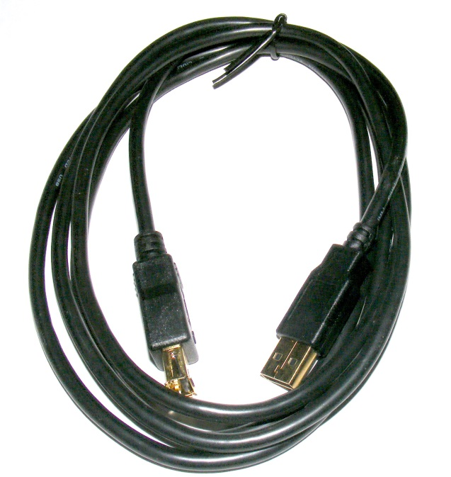
Example of a
Printer Interface with a USB Cable

Slide 9
Abstraction
The concept of communicating about ideas without concern about the implementation of the ideas.

Slide 10
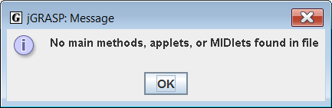
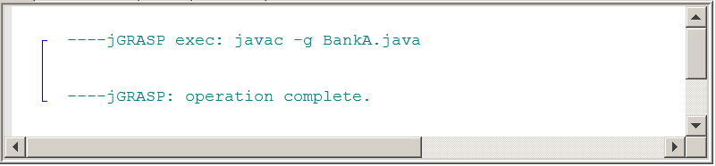
The program compiles but has nothing to execute.
// Interface01A
// This program introduces the abstract <Bank> interface.
// All interface methods are abstract and have no method bodies.
public interface BankA
{
public double getBalance();
public void makeDeposit(double amount);
public void makeWithdrawal(double amount);
}

Slide 11
// Interface01B
// The reserved word abstract is optional.
// In an interface abstract is implied if not used.
public abstract interface BankB
{
public abstract double getBalance();
public abstract void makeDeposit(double amount);
public abstract void makeWithdrawal(double amount);
}

Slide 12
Java Interfaces
A Java Interface provides a group of method signatures that will be available for any client of a class that implements the interface.
Implementation details of the Interface methods are neither required nor desired at the Interface level.

Slide 13
Section 13.3
Implementing
Interfaces

Slide 14
// Interface02
// The <CreditUnion> class implements the <Bank> interface.
public class CreditUnion implements Bank
{
private double balance;
public CreditUnion(double c) { balance = c; }
public double getBalance() { return balance; }
public void makeDeposit(double amount) { balance += amount; }
public void makeWithdrawal(double amount)
{
balance -= amount;
}
}

Slide 15
// Interface02
// The <Runner02> class tests the implementation of the
// <CreditUnion> class and the <Bank> interface.
public class Runner02
{
public static void main (String[ ] args)
{
CreditUnion tom = new CreditUnion(5000.0);
System.out.println("Tom's balance: " + tom.getBalance());
tom.makeDeposit(1500.0);
System.out.println("Tom's balance: " + tom.getBalance());
tom.makeWithdrawal(2500.0);
System.out.println("Tom's balance: " + tom.getBalance());
}
}
Tom's balance: 5000.0
Tom's balance: 6500.0
Tom's balance: 4000.0

Slide 16
Using Implements
First there is an abstract interface, like Bank.
Then comes a concrete class, which implements the interface.
The implementing class uses a different identifier name than the interface Bank name.
This is required, otherwise you get a duplicate identifier error.

Slide 17
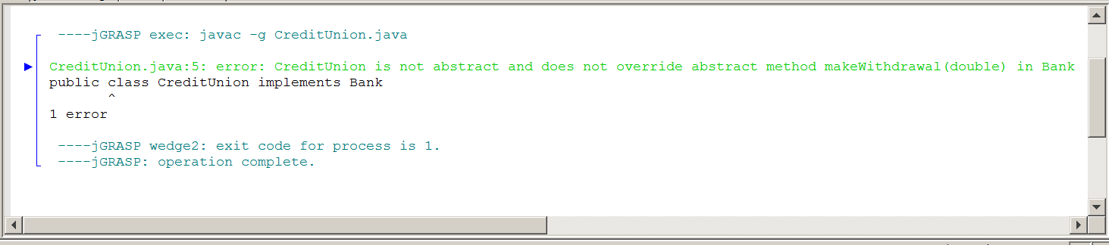
// Interface03
// This <CreditUnion> class partially implements the <Bank> interface.
public class CreditUnion implements Bank
{
private double balance;
public CreditUnion(double c) { balance = c; }
public double getBalance() { return balance; }
public void makeDeposit(double amount) { balance += amount; }
}

Slide 18
Implementation Rule
A class, which implements an interface, must implement every method declared in the interface.

Slide 19
// Interface04
// This <CreditUnion> class defines the <getAccount> method, which was not
// an abstract method of the <Bank> interface. A concrete class may implement
// more methods, but never less methods than are declared in the interface.
public class CreditUnion implements Bank
{
private int account;
private double balance;
public CreditUnion(int a, double c)
{
account = a;
balance = c;
}
public int getAccount() { return account; }
public double getBalance() { return balance; }
public void makeDeposit(double amount) { balance += amount; }
public void makeWithdrawal(double amount) { balance -= amount; }
}

Slide 20
// Interface04
// This program tests the <CreditUnion> class defining more methods
// than are declared in the <Bank> interface.
public class Runner04
{
public static void main (String[ ] args)
{
CreditUnion tom = new CreditUnion(736829056,5000.0);
System.out.println("Tom's account: " + tom.getAccount());
System.out.println("Tom's balance: " + tom.getBalance());
}
}
Tom's account: 736829056
Tom's balance: 5000.0

Slide 21
Section 13.4
Implementing
Multiple
Interfaces

Slide 22
public abstract interface Checking
{
public abstract double getChecking();
public abstract void checkingDeposit(double amount);
public abstract void checkingWithdrawal(double amount);
}
public abstract interface Checking
{
public abstract double getChecking();
public abstract void checkingDeposit(double amount);
public abstract void checkingWithdrawal(double amount);
}

Slide 23
// Interface05
// This program shows how one class, <Bank> can implement two
// interfaces <Checking> and <Savings>.
public class Bank implements Checking,Savings
{
private double checking;
private double savings;
public Bank(double c, double s)
{
checking = c;
savings = s;
}
public double getChecking() { return checking; }
public void checkingDeposit(double amount) { checking += amount; }
public void checkingWithdrawal(double amount) { checking -= amount; }
public double getSavings() { return savings; }
public void savingsDeposit(double amount) { savings += amount; }
public void savingsWithdrawal(double amount) { savings -= amount; }
}

Slide 24
// Interface05
// <Runner05> tests the <Bank> class implementing
// the <Checking> interface and the <Savings> interface.
public class Runner05
{
public static void main (String args[])
{
Bank tom = new Bank(5000.0,7500.0);
System.out.println("Tom's checking balance: " + tom.getChecking());
System.out.println("Tom's savings balance: " + tom.getSavings());
}
}
Tom's checking balance: 5000.0
Tom's savings balance: 7500.0

Slide 25
Section 13.5
Using Fields in
an Interface

Slide 26
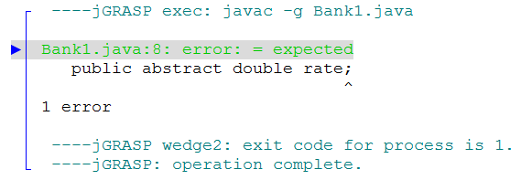
// Interface06
// This <Bank1> interface declares a data field.
// This is only possible if the field has an assigned value.
public abstract interface Bank1
{
public abstract double rate;
public abstract double getBalance();
public abstract void makeDeposit(double amount);
public abstract void makeWithdrawal(double amount);
}

Slide 27
// Interface06
// This <Bank2> interface declares a data field properly.
public interface Bank2
{
public final double rate = 3.25;
public double getBalance();
public void makeDeposit(double amount);
public void makeWithdrawal(double amount);
}

Slide 28
// Interface06
// This <Bank3> class implements the <Bank2> interface
// and also provides a <getRate> method.
public class Bank3 implements Bank2
{
private int account;
private double balance;
public Bank3(int a, double c)
{
account = a;
balance = c;
}
public double getRate() { return rate; }
public int getAccount() { return account; }
public double getBalance() { return balance; }
public void makeDeposit(double amount) { balance += amount; }
public void makeWithdrawal(double amount) { balance -= amount; }
}

Slide 29
Using Fields in an Interface
Fields may be used in an interface declaration.
All fields must have an initialized value.
Field values are constant and cannot be changed.
The final keyword is optional. Final is implied.

Slide 30
// Interface06
// This program tests the <Bank1> interface with a non-abstract
// data field and a <getRate> method in the <Bank2> class.
public class Runner06
{
public static void main (String[ ] args)
{
Bank3 tom = new Bank3(736829056,5000.0);
System.out.println("Tom's account: " + tom.getAccount());
System.out.println("Tom's balance: " + tom.getBalance());
System.out.println("Tom's rate: " + tom.getRate());
System.out.println("Tom's rate: " + tom.rate);
}
}
Tom's account: 736829056
Tom's balance: 5000.0
Tom's rate: 3.25
Tom's rate: 3.25

Slide 31
Interface, Abstract Class and Concrete Class
All methods of an interface must be abstract.
All methods in a concrete class must be concrete and all the methods of the interface must be implemented.
Methods in an abstract class may be abstract or concrete.

Slide 32
Section 13.6
Abstract
Classes

Slide 33
// AbstractClass01
// This is the <HighSchool> interface that will be used for
// the Chapter XIII "interface & abstract class" Case Study .
public abstract interface HighSchool
{
public abstract void information();
public abstract void test();
public abstract void emergency();
public abstract void computeGPA();
public abstract void progress();
public abstract void attendance();
public abstract void dressCode();
public abstract void residence();
public abstract void register();
public abstract void orientation();
public abstract void fundRaising();
public abstract void socialEvents();
public abstract void parking();
}

Slide 34
// AbstractClass02
// This is the <Grade09> implementation of the <HighSchool> interface.
public class Grade09 implements HighSchool
{
public void information() { System.out.println("Process STUDENT information"); }
public void test { System.out.println("Administer pre-enrollment STUDENT testing"); }
public void emergency() { System.out.println("Gather STUDENT emergency forms"); }
public void computeGPA() { System.out.println("Compute STUDENT GPA "); }
public void progress() { System.out.println("Mail STUDENT progress report"); }
public void attendance() { System.out.println("Take STUDENT attendance"); }
public void dressCode { System.out.println("Pass out STUDENT dresscode policies"); }
public void residence() { System.out.println("Process STUDENT residence proof"); }
public void register() { System.out.println("Register 9TH GRADER"); }
public void orientation() { System.out.println("Organize 9TH GRADE orientation"); }
public void fundRaising { System.out.println("Explain 9TH GRADE fund raising"); }
public void socialEvents() { System.out.println("Organize 9TH GRADE social events"); }
public void parking { System.out.println("9TH GRADE students have no parking lot"); }
}

Slide 35
// AbstractClass02
// This is the <Grade10> implementation of the <HighSchool> interface.
public class Grade10 implements HighSchool
{
public void information() { System.out.println("Process STUDENT information"); }
public void test { System.out.println("Administer pre-enrollment STUDENT testing"); }
public void emergency() { System.out.println("Gather STUDENT emergency forms"); }
public void computeGPA() { System.out.println("Compute STUDENT GPA "); }
public void progress() { System.out.println("Mail STUDENT progress report"); }
public void attendance() { System.out.println("Take STUDENT attendance"); }
public void dressCode { System.out.println("Pass out STUDENT dresscode policies"); }
public void residence() { System.out.println("Process STUDENT residence proof"); }
public void register() { System.out.println("Register 10TH GRADER"); }
public void orientation() { System.out.println("Organize 10TH GRADE orientation"); }
public void fundRaising { System.out.println("Explain 10TH GRADE fund raising"); }
public void socialEvents() { System.out.println("Organize 10TH GRADE social events"); }
public void parking { System.out.println("10TH GRADE students have no parking lot"); }
}

Slide 36
// AbstractClass02
// This is the <Grade11> implementation of the <HighSchool> interface.
public class Grade11 implements HighSchool
{
public void information() { System.out.println("Process STUDENT information"); }
public void test { System.out.println("Administer pre-enrollment STUDENT testing"); }
public void emergency() { System.out.println("Gather STUDENT emergency forms"); }
public void computeGPA() { System.out.println("Compute STUDENT GPA "); }
public void progress() { System.out.println("Mail STUDENT progress report"); }
public void attendance() { System.out.println("Take STUDENT attendance"); }
public void dressCode { System.out.println("Pass out STUDENT dresscode policies"); }
public void residence() { System.out.println("Process STUDENT residence proof"); }
public void register() { System.out.println("Register 11TH GRADER"); }
public void orientation() { System.out.println("Organize 11TH GRADE orientation"); }
public void fundRaising { System.out.println("Explain 11TH GRADE fund raising"); }
public void socialEvents() { System.out.println("Organize 11TH GRADE social events"); }
public void parking { System.out.println("Distribute 11TH GRADE parking lot stickers"); }
}

Slide 37
// AbstractClass02
// This is the <Grade12> implementation of the <HighSchool> interface.
public class Grade12 implements HighSchool
{
public void information() { System.out.println("Process STUDENT information"); }
public void test { System.out.println("Administer pre-enrollment STUDENT testing"); }
public void emergency() { System.out.println("Gather STUDENT emergency forms"); }
public void computeGPA() { System.out.println("Compute STUDENT GPA "); }
public void progress() { System.out.println("Mail STUDENT progress report"); }
public void attendance() { System.out.println("Take STUDENT attendance"); }
public void dressCode { System.out.println("Pass out STUDENT dresscode policies"); }
public void residence() { System.out.println("Process STUDENT residence proof"); }
public void register() { System.out.println("Register 12TH GRADER"); }
public void orientation() { System.out.println("Organize 12TH GRADE orientation"); }
public void fundRaising { System.out.println("Explain 12TH GRADE fund raising"); }
public void socialEvents() { System.out.println("Organize 12TH GRADE social events"); }
public void parking { System.out.println("Distribute 12TH GRADE parking lot stickers"); }
}

Slide 38
// AbstractClass02
// This program tests the abstract interface and its four implementing classes.
public class Test02
{
public static void main(String[] args)
{
HighSchool tom = new Grade09();
HighSchool sue = new Grade10();
HighSchool bob = new Grade11();
HighSchool ann = new Grade12();
System.out.println("TEST 9TH GRADE TOM");
tom.information();
tom.test();
tom.emergency();
tom.computeGPA();
tom.progress();
tom.attendance();
tom.dressCode();
tom.residence();
tom.register();
tom.orientation();
tom.fundRaising();
tom.socialEvents();
tom.parking();
System.out.println();

Slide 39
System.out.println("TEST 10TH GRADE SUE");
sue.information();
sue.test();
sue.emergency();
sue.computeGPA();
sue.progress();
sue.attendance();
sue.dressCode();
sue.residence();
sue.register();
sue.orientation();
sue.fundRaising();
sue.socialEvents();
sue.parking();
System.out.println();
System.out.println("TEST 11TH GRADE BOB");
bob.information();
bob.test();
bob.emergency();
bob.computeGPA();
bob.progress();
bob.attendance();
bob.dressCode();
bob.residence();
bob.register();
bob.orientation();
bob.fundRaising();
bob.socialEvents();
bob.parking();
System.out.println();
System.out.println("TEST 12TH GRADE ANN");
ann.information();
ann.test();
ann.emergency();
ann.computeGPA();
ann.progress();
ann.attendance();
ann.dressCode();
ann.residence();
ann.register();
ann.orientation();
ann.fundRaising();
ann.socialEvents();
ann.parking();
System.out.println();
}
}

Slide 40
TEST 9TH GRADE TOM
Process STUDENT information
Administer pre-enrollment STUDENT testing
Gather STUDENT emergency forms
Compute STUDENT GPA
Mail STUDENT progress report
Take STUDENT attendance
Pass out STUDENT dresscode policies
Process STUDENT residence proof
Register 9TH GRADER
Organize 9TH GRADE orientation
Explain 9TH GRADE fund raising
Organize 9TH GRADE social events
9TH GRADE students have no parking lot
TEST 10TH GRADE SUE
Process STUDENT information
Administer pre-enrollment STUDENT testing
Gather STUDENT emergency forms
Compute STUDENT GPA
Mail STUDENT progress report
Take STUDENT attendance
Pass out STUDENT dresscode policies
Process STUDENT residence proof
Register 10TH GRADER
Organize 10TH GRADE orientation
Explain 10TH GRADE fund raising
Organize 10TH GRADE social events
10TH GRADE students have no parking lot
TEST 11TH GRADE BOB
Process STUDENT information
Administer pre-enrollment STUDENT testing
Gather STUDENT emergency forms
Compute STUDENT GPA
Mail STUDENT progress report
Take STUDENT attendance
Pass out STUDENT dresscode policies
Process STUDENT residence proof
Register 11TH GRADER
Organize 11TH GRADE orientation
Explain 11TH GRADE fund raising
Organize 11TH GRADE social events
Distribute 11TH GRADE parking lot stickers
TEST 12TH GRADE ANN
Process STUDENT information
Administer pre-enrollment STUDENT testing
Gather STUDENT emergency forms
Compute STUDENT GPA
Mail STUDENT progress report
Take STUDENT attendance
Pass out STUDENT dresscode policies
Process STUDENT residence proof
Register 12TH GRADER
Organize 12TH GRADE orientation
Explain 12TH GRADE fund raising
Organize 12TH GRADE social events
Distribute 12TH GRADE parking lot stickers

Slide 41
Section 13.7
Abstract Class
as a Bridge Class

Slide 42
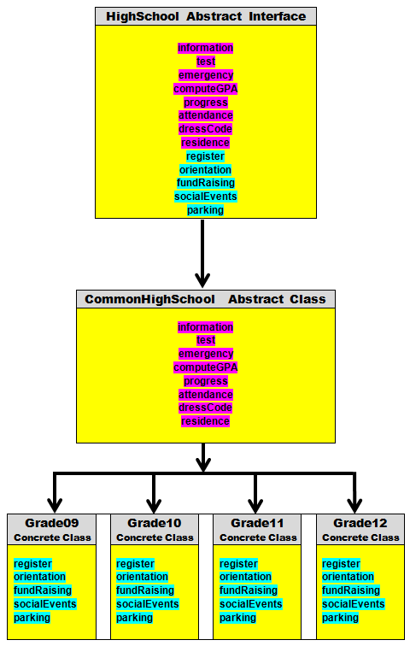

Slide 43
// AbstractClass03
// This is the <CommonHighSchool> abstract class implementation
// of the <HighSchool> interface. All methods that are implemented
// individually by grade are left abstract.
public abstract class CommonHighSchool implements HighSchool
{
public void information { System.out.println("Process STUDENT information"); }
public void test { System.out.println("Administer pre-enrollment STUDENT testing"); }
public void emergency { System.out.println("Gather STUDENT emergency forms"); }
public void computeGPA { System.out.println("Compute STUDENT GPA "); }
public void progress { System.out.println("Mail STUDENT progress report"); }
public void attendance() { System.out.println("Take STUDENT attendance"); }
public void dressCode { System.out.println("Pass out STUDENT dresscode policies"); }
public void residence { System.out.println("Process STUDENT residence proof"); }
public abstract void register();
public abstract void orientation();
public abstract void fundRaising();
public abstract void socialEvents();
public abstract void parking();
}

Slide 44
// AbstractClass03
// This is the <Grade09> subclass of <CommonHighSchool>.
public class Grade09 extends CommonHighSchool
{
public void register() { System.out.println("Register 9TH GRADER"); }
public void orientation() { System.out.println("Organize 9TH GRADE orientation"); }
public void fundRaising { System.out.println("Explain 9TH GRADE fund raising"); }
public void socialEvents() { System.out.println("Organize 9TH GRADE social events"); }
public void parking { System.out.println("9TH GRADE students have no parking lot"); }
}
// AbstractClass03
// This is the <Grade10> subclass of <CommonHighSchool>.
public class Grade10 extends CommonHighSchool
{
public void register() { System.out.println("Register 10TH GRADER"); }
public void orientation() { System.out.println("Organize 10TH GRADE orientation"); }
public void fundRaising { System.out.println("Explain 10TH GRADE fund raising"); }
public void socialEvents() { System.out.println("Organize 10TH GRADE social events"); }
public void parking { System.out.println("10TH GRADE students have no parking lot"); }
}

Slide 45
// AbstractClass03
// This is the <Grade11> subclass of <CommonHighSchool>.
public class Grade11 extends CommonHighSchool
{
public void register() { System.out.println("Register 11TH GRADER"); }
public void orientation() { System.out.println("Organize 11TH GRADE orientation"); }
public void fundRaising { System.out.println("Explain 11TH GRADE fund raising"); }
public void socialEvents() { System.out.println("Organize 11TH GRADE social events"); }
public void parking { System.out.println("Distribute 11TH GRADE parking lot stickers"); }
}
}
// AbstractClass03
// This is the <Grade12> subclass of <CommonHighSchool>.
public class Grade12 extends CommonHighSchool
{
public void register() { System.out.println("Register 12TH GRADER"); }
public void orientation() { System.out.println("Organize 12TH GRADE orientation"); }
public void fundRaising { System.out.println("Explain 12TH GRADE fund raising"); }
public void socialEvents() { System.out.println("Organize 12TH GRADE social events"); }
public void parking { System.out.println("Distribute 12TH GRADE parking lot stickers"); }
}

Slide 46
// AbstractClass04
// This is the <CommonHighSchool> abstract class implementation
// of the <HighSchool> interface. All methods that are are not
// implemented are not shown, as they were in Stage #3.
public abstract class CommonHighSchool implements HighSchool
{
public void information { System.out.println("Process STUDENT information"); }
public void test { System.out.println("Administer pre-enrollment STUDENT testing"); }
public void emergency { System.out.println("Gather STUDENT emergency forms"); }
public void computeGPA { System.out.println("Compute STUDENT GPA "); }
public void progress { System.out.println("Mail STUDENT progress report"); }
public void attendance() { System.out.println("Take STUDENT attendance"); }
public void dressCode { System.out.println("Pass out STUDENT dresscode policies"); }
public void residence { System.out.println("Process STUDENT residence proof"); }
}

Slide 47
// AbstractClass05
// This is an abstract class with all methods implemented,
// but none of them - intentionally - in a functional manner.
public abstract class HighSchoolAdapter implements HighSchool
{
public void information() { }
public void test() { }
public void emergency() { }
public void computeGPA() { }
public void progress() { }
public void attendance() { }
public void dressCode() { }
public void residence() { }
public void register() { }
public void orientation() { }
public void fundRaising() { }
public void socialEvents() { }
public void parking() { }
}

Slide 48
// AbstractClass05
// This is the <Grade09> implementation of the <HighSchool> interface.
// None of the other methods have to be implemented anymore.
public class Grade09A implements HighSchool
{
public void information()
{
System.out.println("Process 9TH GRADE information");
}
public void test() { }
public void emergency() { }
public void computeGPA() { }
public void progress() { }
public void attendance() { }
public void dressCode() { }
public void residence() { }
public void register() { }
public void orientation() { }
public void fundRaising() { }
public void socialEvents() { }
public void parking() { }
}

Slide 49
// AbstractClass05
// This is the <Grade09B> extension of the <HighSchoolAdapter> abstract class.
// None of the other methods have to be implemented anymore.
public class Grade09B extends HighSchoolAdapter
{
public void information()
{
System.out.println("Process 9TH GRADE information");
}
}

Slide 50
// AbstractClass05
// This program tests the abstract HighSchool interface,
// the HighSchoolAdapter abstract class and
// the Grade09B concrete class.
public class Test05
{
public static void main(String[] args)
{
HighSchool tom = new Grade09B();
tom.information();
}
}
Process 9TH GRADE information

Slide 51
// AbstractClass06
// This abstract class has a constructor.
// This stage tests to see if a constructor in an abstract class can be called and used by a subclass.
public abstract class CommonHighSchool implements HighSchool
{
public CommonHighSchool()
{
System.out.println("CommonHighSchool Constructor");
}
public void information { System.out.println("Process STUDENT information"); }
public void test { System.out.println("Administer pre-enrollment STUDENT testing"); }
public void emergency { System.out.println("Gather STUDENT emergency forms"); }
public void computeGPA { System.out.println("Compute STUDENT GPA "); }
public void progress { System.out.println("Mail STUDENT progress report"); }
public void attendance() { System.out.println("Take STUDENT attendance"); }
public void dressCode { System.out.println("Pass out STUDENT dresscode policies"); }
public void residence { System.out.println("Process STUDENT residence proof"); }
}

Slide 52
// AbstractClass06
// This program tests if a subclass can call and use a constructor in an abstract class.
public class Grade09 extends CommonHighSchool
{
public Grade09()
{
super();
System.out.println("Grade09 Constructor");
}
public void register { System.out.println("Register 9TH GRADER"); }
public void orientation() { System.out.println("Organize 9TH GRADE orientation"); }
public void fundRaising() { System.out.println("Explain 9TH GRADE fund raising"); }
public void socialEvents() { System.out.println("Organize 9TH GRADE social events"); }
public void parking { System.out.println("9TH GRADE students have no parking lot"); }
}

Slide 53
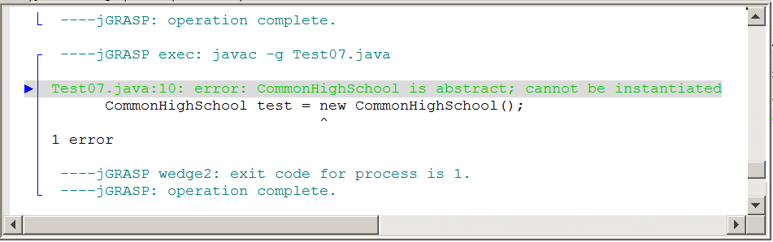
// AbstractClass07
// This program tests if you can
// instantiate an abstract class.
public class Test07
{
public static void main(String[ ] args)
{
CommonHighSchool test = new CommonHighSchool();
}
}

Slide 54

Section 13.8
Behind the
Generics Curtain

Slide 55
// Generics01
// This is an example of using <ArrayList> with “generics”.
import java.util.ArrayList;
public class GenericsDemo
{
public static void main (String[] args)
{
ArrayList<String> names = new ArrayList<String>();
ArrayList<Person> people = new ArrayList<Person>();
}
}
class Person
{
private String name;
private int age;
public Person(String n, int a)
{
name = n;
age = a;
}
}

Slide 56
// Generics01
// This is how the <List> interface appears on the College Board
interface List<E>
{
public int Size();
public boolean add(E obj);
public void add(int index, E obj);
public E get(int index);
public E set(int index, E obj);
public E remove(int index);
}
What
exactly is this E
thing?

Slide 57
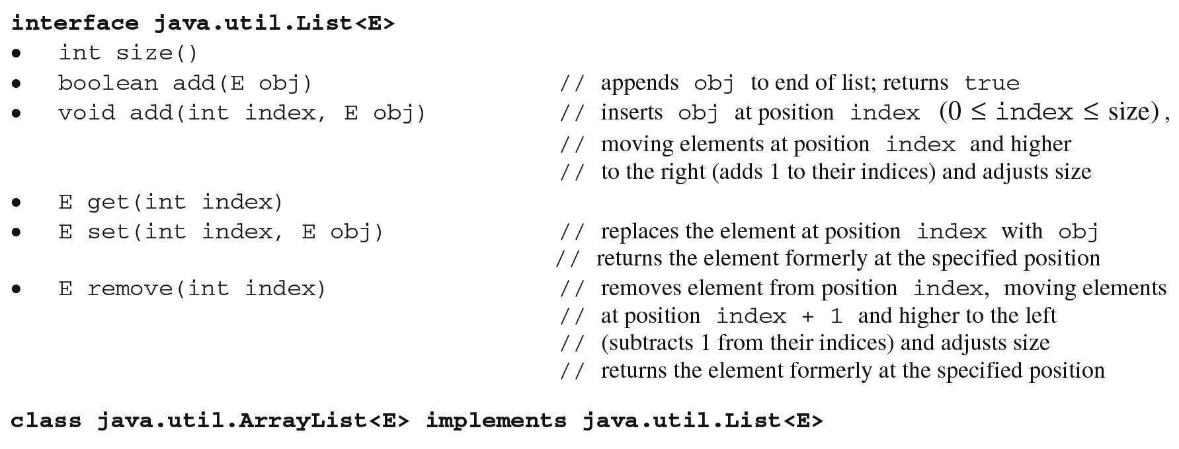

Slide 58
// Generics02
// This <IntList> interface strictly specializes with methods to
// process <int> variables only.
public interface IntList
{
public int size();
public void add(int nbr);
public void add(int index, int nbr);
public int get(int index);
public void set(int index, int nbr);
public int remove(int index);
}

Slide 59
// Generics02
// The <IntArray> "concrete" class implements the <IntList> "abstract" interface.
public class IntArray implements IntList
{
private int[] array;
private int size;
public IntArray()
{
array = new int[10000];
size = 0;
}
public int size() { return size; }
public void add(int nbr)
{
array[size] = nbr;
size++;
}
public void add(int index, int nbr)
{
size++;
for (int k = size-1; k > index; k--)
array[k] = array[k-1];
array[index] = nbr;
}
public int get(int index)
{
return array[index];
}
public void set(int index, int nbr)
{
array[index] = nbr;
}
public int remove(int index)
{
int temp = array[index];
for (int k = index; k < size-1; k++)
array[k] = array[k+1];
size--;
return temp;
}
public String toString()
{
String temp = "[";
for (int k = 0; k < size-1; k++)
temp = temp + array[k] + ", ";
temp = temp + array[size-1] + "]" + "\n";
return temp;
}
}

Slide 60
// Generics02
// This class tests the <IntArray> implementation of the <IntList> interface.
public class Runner02
{
public static void main (String[] args)
{
IntArray numbers = new IntArray();
for (int k = 0; k < 10; k++)
numbers.add(k + 100);
System.out.println(numbers);
numbers.add(10,999);
numbers.add(0,999);
System.out.println(numbers);
for (int k = 0; k < numbers.size(); k++)
System.out.print(numbers.get(k) + " ");
System.out.println("\n");
numbers.set(3,555);
numbers.set(6,555);
System.out.println(numbers);
numbers.remove(3);
numbers.remove(6);
System.out.println(numbers);
}
}
[100, 101, 102, 103, 104, 105, 106, 107, 108, 109]
[999, 100, 101, 102, 103, 104, 105, 106, 107, 108, 109, 999]
999 100 101 102 103 104 105 106 107 108 109 999
[999, 100, 101, 555, 103, 104, 555, 106, 107, 108, 109, 999]
[999, 100, 101, 103, 104, 555, 107, 108, 109, 999]

Slide 61
// Generics03A
// This <ObjArray> class is declared as a "generic" class.
// "Class Parameter" <E> takes on the value of the data type
// when a new <ObjArray> object is instantiated.
public class ObjArray<E>
{
private Object[] array;
private int size;
public ObjArray()
{
array = new Object[10000];
size = 0;
}
public int size() { return size; }
public void add(E obj)
{
array[size] = obj;
size++;
}

Slide 62
public void add(int index, E obj)
{
size++;
for (int k = size-1; k > index; k--)
array[k] = array[k-1];
array[index] = obj;
}
public E get(int index)
{
return (E) array[index];
}
public void set(int index, E obj)
{
array[index] = obj;
}

Slide 63
public E remove(int index)
{
E temp = (E) array[index];
for (int k = index; k < size-1; k++)
array[k] = array[k+1];
size--;
return (E) temp;
}
public String toString()
{
String temp = "[";
for (int k = 0; k < size-1; k++)
temp = temp + array[k] + ", ";
temp = temp + array[size-1] + "]" + "\n";
return temp;
}
}

Slide 64
// Generics03A
// The <Runner03> class tests the "generic" <ObjArray> class.
public class Runner03
{
public static void main (String[] args)
{
ObjArray<String> names = new ObjArray<String>();
names.add("Isolde");
names.add("John");
names.add("Greg");
names.add("Maria");
names.add("Heidi");
System.out.println(names);
names.add(5,"Braxi");
names.add(0,"Marie");
System.out.println(names);
for (int k = 0; k < names.size(); k++)
System.out.print(names.get(k) + " ");
System.out.println("\n");
names.set(3,"Aardvark");
names.set(4,"Aardvark");
System.out.println(names);
names.remove(3);
names.remove(4);
System.out.println(names);
}
}
[Isolde, John, Greg, Maria, Heidi]
[Marie, Isolde, John, Greg, Maria, Heidi, Braxi]
Marie Isolde John Greg Maria Heidi Braxi
[Marie, Isolde, John, Aardvark, Aardvark, Heidi, Braxi]
[Marie, Isolde, John, Aardvark, Braxi]

Slide 65
// Generics03B
// This <ObjArray> class is declared as a "generic" class.
// The is almost identical to the Generics03A file.
// All the methods do the same process.
// The only difference is that <E> is now <Aardvark>.
public class ObjArray<Aardvark>
{
private Object[] array;
private int size;
public ObjArray()
{
array = new Object[10000];
size = 0;
}
public int size() { return size; }
public void add(Aardvark obj)
{
array[size] = obj;
size++;
}

Slide 66
public void add(int index, Aardvark obj)
{
size++;
for (int k = size-1; k > index; k--)
array[k] = array[k-1];
array[index] = obj;
}
public Aardvark get(int index)
{
return (E) array[index];
}
public void set(int index, Aardvark obj)
{
array[index] = obj;
}

Slide 67
public Aardvark remove(int index)
{
Aardvark temp = (Aardvark) array[index];
for (int k = index; k < size-1; k++)
array[k] = array[k+1];
size--;
return (Aardvark) temp;
}
public String toString()
{
String temp = "[";
for (int k = 0; k < size-1; k++)
temp = temp + array[k] + ", ";
temp = temp + array[size-1] + "]" + "\n";
return temp;
}
}

Slide 68
The Logic Behind the “Generics” Name
With medicine we understand a "generic" drug to be one that does not have a brand-name requirement. Consider the following class heading:
public class Hospital<E>
It is not known what data type will be used by the Hospital class. In this case E may be objects of the Patient class or Person class. It does not matter. The class is designed to accept what is decided in an actual client program. Now look at the following instantiation:
Hospital<Person> h = new Hospital<Person>()
The confusion occurs when people look at the generic declaration, like the Hospital one. That is not generic. It is very specific. It states that the Hospital class will use Person objects. To understand the name generics you must look at the class declaration and there you see the very generic letter E, which indicates that a specific data type is not required.

Slide 69
Section 13.9
The Generic
List Interface

Slide 70
// Generics04
// This is how the <List> interface appears on the College Board
interface List<E>
{
public int Size();
public boolean add(E obj);
public void add(int index, E obj);
public E get(int index);
public E set(int index, E obj);
public E remove(int index);
}

Slide 71
// Generics04
// The <ObjArray> class implements the <List> interface.
public class ObjArray<E> implements List<E>
{
private Object[] array;
private int size;
public ObjArray()
{
array = new Object[10000];
size = 0;
}
public int size()
{
return size;
}
public boolean add(E obj)
{
array[size] = obj;
size++;
return true;
}

Slide 72
public void add(int index, E obj)
{
size++;
for (int k = size-1; k > index; k--)
array[k] = array[k-1];
array[index] = obj;
}
public E get(int index)
{
return (E) array[index];
}
public E set(int index, E obj)
{
E temp = (E) array[index];
array[index] = obj;
return temp;
}

Slide 73
public E remove(int index)
{
E temp = (E) array[index];
for (int k = index; k < size-1; k++)
array[k] = array[k+1];
size--;
return (E) temp;
}
public String toString()
{
String temp = "[";
for (int k = 0; k < size-1; k++)
temp = temp + array[k] + ", ";
temp = temp + array[size-1] + "]" + "\n";
return temp;
}
}

Slide 74
// Generics04
// The <Runner04> class tests the "generic" <ObjArray> class.
public class Runner04
{
public static void main (String[] args)
{
ObjArray<String> names = new ObjArray<String>();
names.add("Isolde");
names.add("John");
names.add("Greg");
names.add("Maria");
names.add("Heidi");
System.out.println(names);
names.add(0,"Braxi");
names.add(6,"Marie");
System.out.println(names);
for (int k = 0; k < names.size(); k++)
System.out.print(names.get(k) + " ");
System.out.println("\n");
names.set(3,"Aardvark");
System.out.println(names.set(4,"Aardvark"));
System.out.println(names);
names.remove(3);
names.remove(4);
System.out.println(names);
}
}
[Isolde, John, Greg, Maria, Heidi]
[Braxi, Isolde, John, Greg, Maria, Heidi, Marie]
Braxi Isolde John Greg Maria Heidi Marie
Maria
[Braxi, Isolde, John, Aardvark, Aardvark, Heidi, Marie]
[Braxi, Isolde, John, Aardvark, Marie]

Slide 75
Section 13.10
Generics and
SubInterfaces

Slide 76
Java Collection Hierarchy
Collection
interface
List
subinterface
Set
subinterface
ArrayList
class
LinkedList
class
HashSet
class
TreeSet
class

Slide 77
// Generics05A
// In this example <Collection> is an interface.
// <List> is a subinterface, which extends <Collection>.
// <MyList> implements <List> and by extension also <Collection>.
// This is not a practical example of using a subinterface.
public interface CollectionA
{
public boolean add(int nbr);
public boolean isEmpty();
}
interface List extends CollectionA
{
public int get(int index);
}
class MyList implements List
{
public boolean add (int nbr) { return true; }
public boolean isEmpty() { return true; }
public int get(int index) { return 0; }
}

Slide 78
// Generics05B
// In this example <Collection> is an interface.
// <List> is a subinterface, which extends <Collection>.
// <Set> is also a subinterface, which extends <Collection>.
// <MyList> implements <List> and by extension also <Collection>.
// <MySet> implements <Set> and by extension also <Collection>.
public interface CollectionB
{
public boolean add(int nbr);
public boolean isEmpty();
}
interface List extends CollectionB
{
public int get(int index);
}
interface Set extends CollectionB
{
public boolean contain(int nbr);
}
class MyList implements List
{
public boolean add (int nbr) { return true; }
public boolean isEmpty() { return true; }
public int get(int index) { return 0; }
}
class MySet implements Set
{
public boolean add (int nbr) { return true; }
public boolean isEmpty() { return true; }
public boolean contain(int nbr) { return true; }
}

Slide 79
// Generics06
// The <int> interfaces and classes are now replaced by generics.
// All the methods are the same as in Generics05B, but now the
// a specific class can be used when instantiating a <MyList> or <MySet> object.
public interface Collection<E>
{
public void add(E obj);
public boolean isEmpty();
}
interface List<E> extends Collection<E>
{
public E get(int index);
}
interface Set<E> extends Collection<E>
{
public boolean contain(E obj);
}
class MyList<E> implements List<E>
{
public void add (E obj) { }
public boolean isEmpty() { return true; }
public E get(int index) { return null; }
}
class MySet<E> implements Set<E>
{
public void add (E obj) { }
public boolean isEmpty() { return true; }
public boolean contain(E obj) { return true; }
}

Slide 80
// Generics07
// The <Collection> interface starts with methods
// <add> and <isEmpty>.
public interface Collection<E>
{
public boolean add(E obj);
public boolean isEmpty();
}

Slide 81
// Generics07
// The <List> subinterface adds the <get> method to the
// <add> and <isEmpty> methods.
public interface List<E> extends Collection<E>
{
public E get(int index);
}

Slide 82
// Generics07
// The <MyList> class implements the <List> subinterface
// Compare the <add> method with the <MySet> code of <add>.
public class MyList<E> implements List<E>
{
private int size;
private Object[] objects;
public MyList(int n)
{
objects = new Object[n];
size = 0;
}
public boolean add (E obj)
{
objects[size] = obj;
size++;
return true;
}
public boolean isEmpty() { return size == 0; }
public E get(int index)
{
return (E) objects[index];
}
public String toString()
{
String temp = "";
for (int k = 0; k < size; k++)
temp = temp + objects[k] + "\n";
return temp;
}
}

Slide 83
// Generics07
// The <MySet> class implements the <Set> subinterface
// Compare the <add> method with the <MyList> code of <add>.
public class MySet<E> implements List<E>
{
private int size;
private Object[] objects;
public MySet(int n)
{
objects = new Object[n];
size = 0;
}
public boolean add (E obj)
{
if (contain(obj))
return false;
else
{
objects[size] = obj;
size++;
return true;
}
}
public boolean isEmpty()
{
return size == 0;
}
public E get(int index)
{
return (E) objects[index];
}
public String toString()
{
String temp = "";
for (int k = 0; k < size; k++)
temp = temp + objects[k] + "\n";
return temp;
}
}

Slide 84
Compare MyList add to MySet add
MyList add method | MySet add method
public boolean add (E obj) { objects[size] = obj; size++; return true; } | public boolean add (E obj) { if (contain(obj)) return false; else { objects[size] = obj; size++; return true; } }
You can add any elements to a list, but you can only add non-duplicate elements to a set.

Slide 85
// Generics07
// <Runner07> the difference between the <MyList> and <MySet> implementations.
// Note how the <add> method is not the same for a list or a set. A set does not contain duplicate objects.
public class Runner07
{
public static void main(String[] args)
{
MyList<String> cats = new MyList<String>(1000);
cats.add("Tiger");
cats.add("Lion");
cats.add("Leopard");
cats.add("Cheetah");
cats.add("Panther");
cats.add("Leopard");
System.out.println(cats);
MySet<String> birds = new MySet<String>(1000);
birds.add("Eagle");
birds.add("Falcon");
birds.add("Owl");
birds.add("Pigeon");
birds.add("Cardinal");
birds.add("Falcon");
System.out.println(birds);
}
}
Tiger
Lion
Leopard
Cheetah
Panther
Leopard
Eagle
Falcon
Owl
Pigeon
Cardinal

Slide 86
Interfaces vs. Abstract Classes
Interface | Abstract Class
Abstract methods only | Abstract and concrete methods
No constructor allowed | Can have a constructor
Needs a class to implement the interface | Needs a subclass to implement the abstract methods
Only final attributes are allowed. | Any attribute is allowed.
Cannot instantiate an object | Cannot instantiate an object
The keyword abstract is implied. | The keyword abstract is required.
The keyword final is implied for all attributes. | The keyword final is required for all final attributes.

